Slide 1
Sequence Similarity
Searching
ppt credit: partial from MIT opencourse

Slide 2
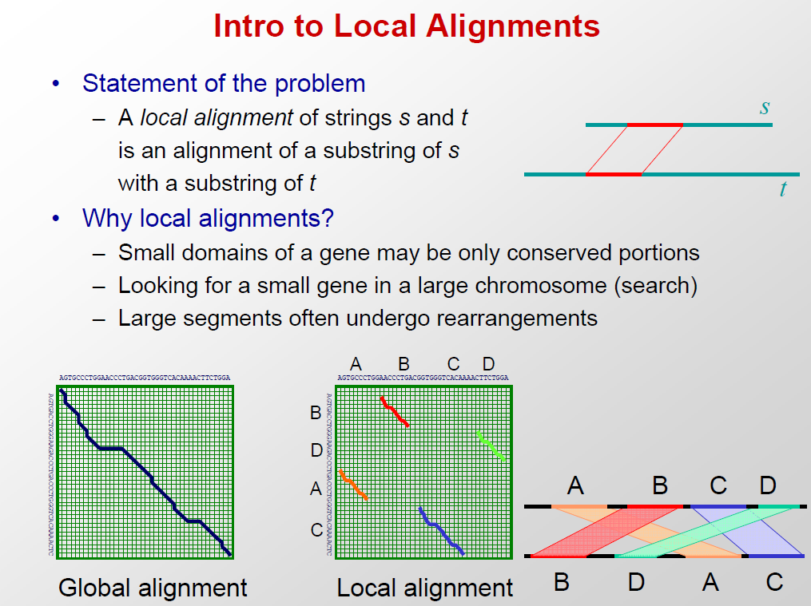


Slide 3
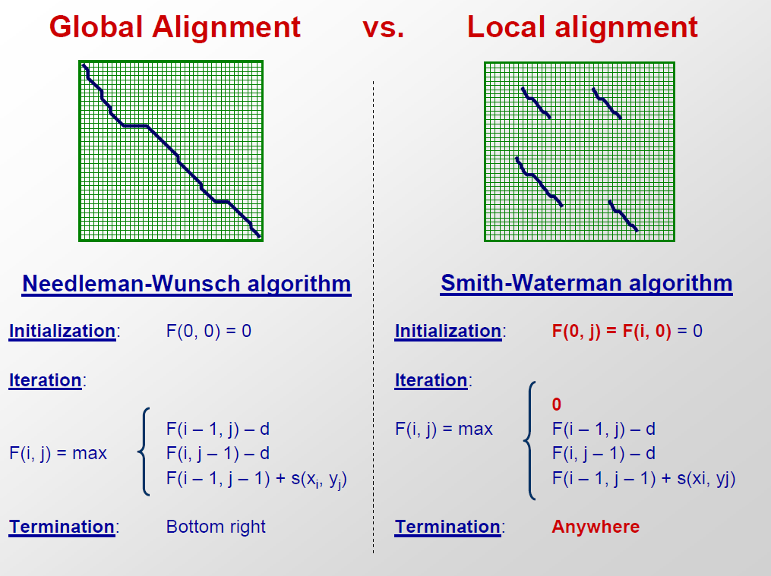

Slide 4
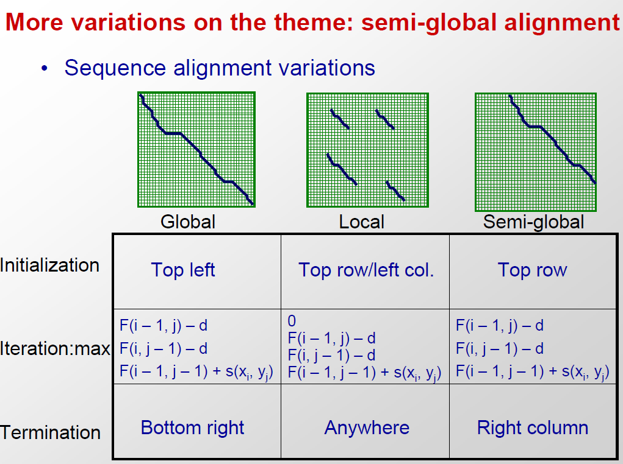

Slide 5
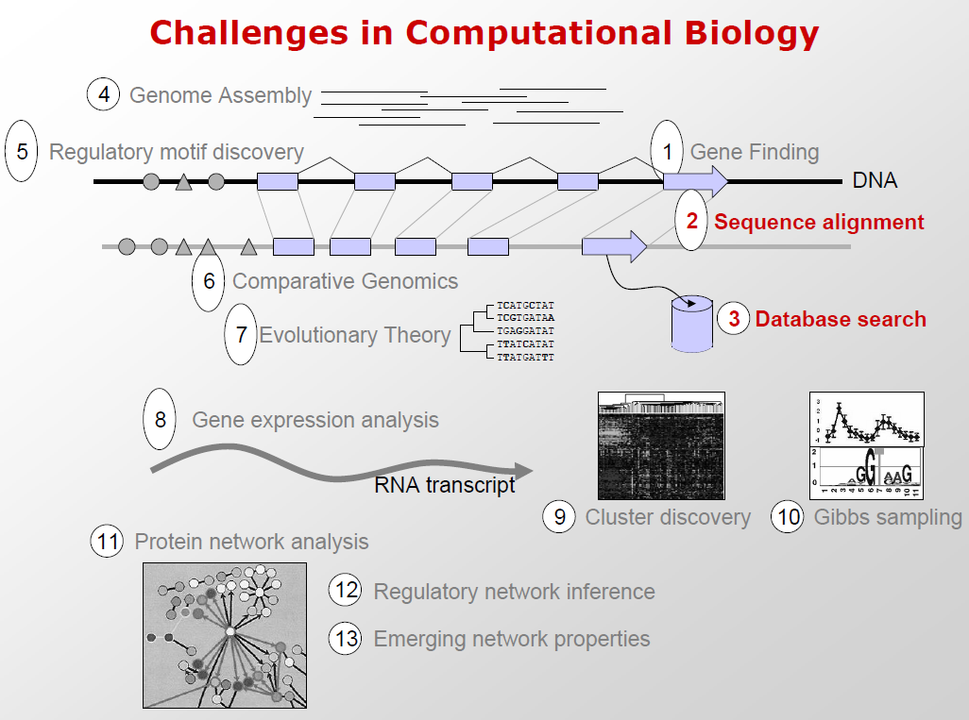

Slide 6
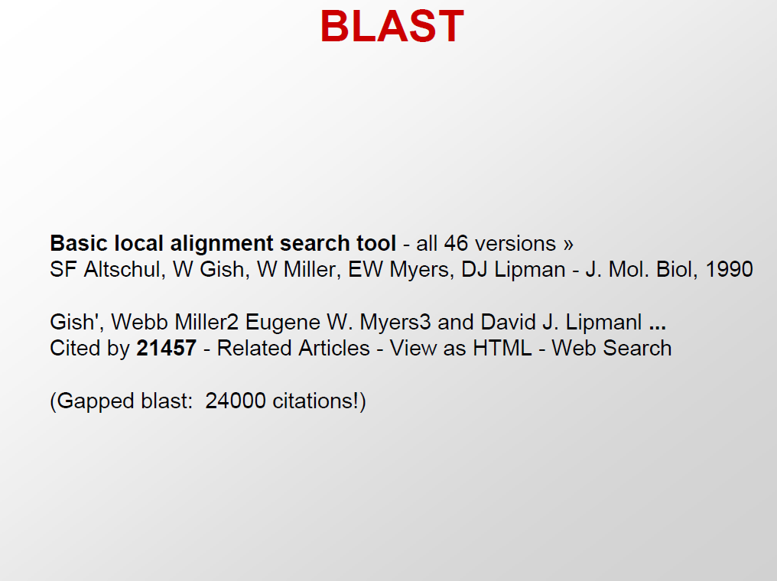

Slide 7
Why Compare Sequences?
Identify sequences found in lab experiments
    What is this thing I just found?
Compare new genes to known ones
Compare genes from different species
    information about evolution
Guess functions for entire genomes full of new gene sequences

Slide 8
Are there other sequences like this one?
1) Huge public databases - GenBank, Swissprot, etc.
2) Sequence comparison is the most powerful and reliable method to determine evolutionary relationships between genes
3) Similarity searching is based on alignment
4) BLAST and FASTA provide rapid similarity searching
  rapid = approximate

Slide 9
_x0013_Similarity is based on Alignment
GATGCCATAGAGCTGTAGTCGTACCCT <—
—> CTAGAGAGC-GTAGTCAGAGTGTCTTTGAGTTCC

Slide 10
Similarity ≠ Homology
1) 25% similarity ≥ 100 AAs is strong evidence for homology
2) Homology is an evolutionary statement which means “descent from a common ancestor”
  common 3D structure
  usually common function
  homology is all or nothing, you cannot say "50% homologous"

Slide 11
Alignment is Based on Dot Plots
1) two sequences on vertical and horizontal axes of graph
2) put dots wherever there is a match
3) diagonal line is region of identity
(local alignment)
4) apply a window filter - look at a group of bases, must meet % identity to get a dot

Slide 12
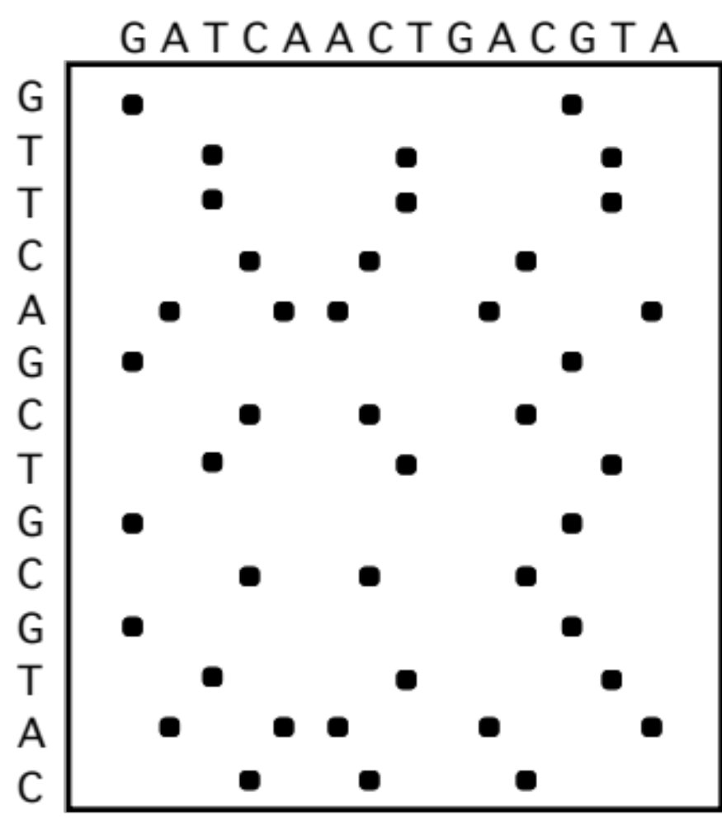
Simple Dot Plot

Slide 13
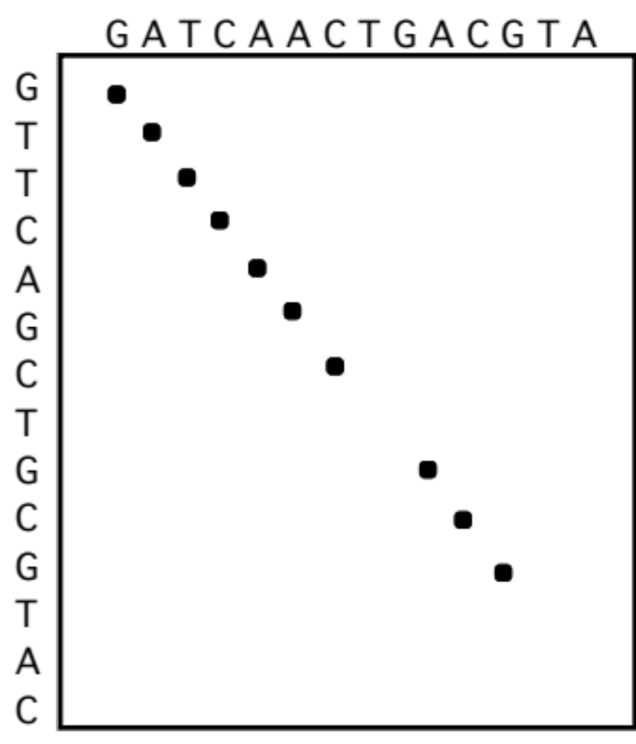
Dot plot filtered with 4 base window and 75% identity

Slide 14
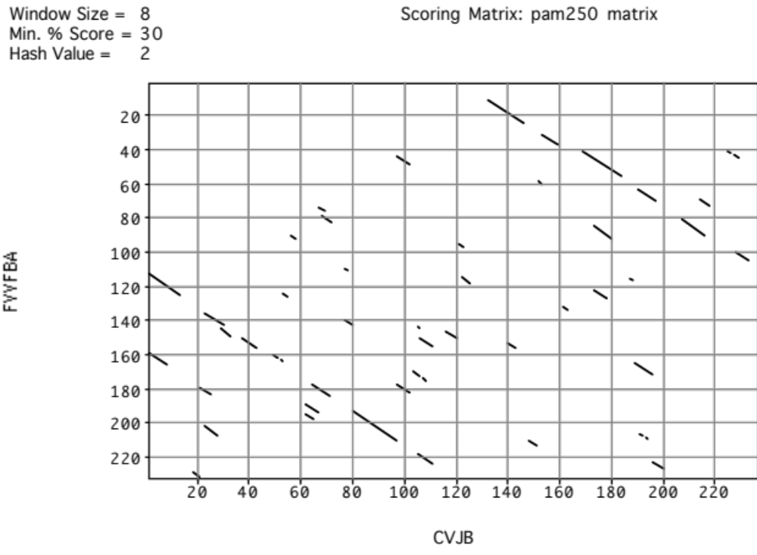
Dot plot of real data

Slide 15
BLAST Searches GenBank
[BLAST= Basic Local Alignment Search Tool]
The NCBI BLAST web server lets you compare your query sequence to various sections of GenBank:
      nr = non-redundant (main sections)
      month = new sequences from the past few weeks
      ESTs
      human, drososphila, yeast, or E.coli genomes
      proteins (by automatic translation)
This is a VERY fast and powerful computer.
Notes:
27

Slide 16
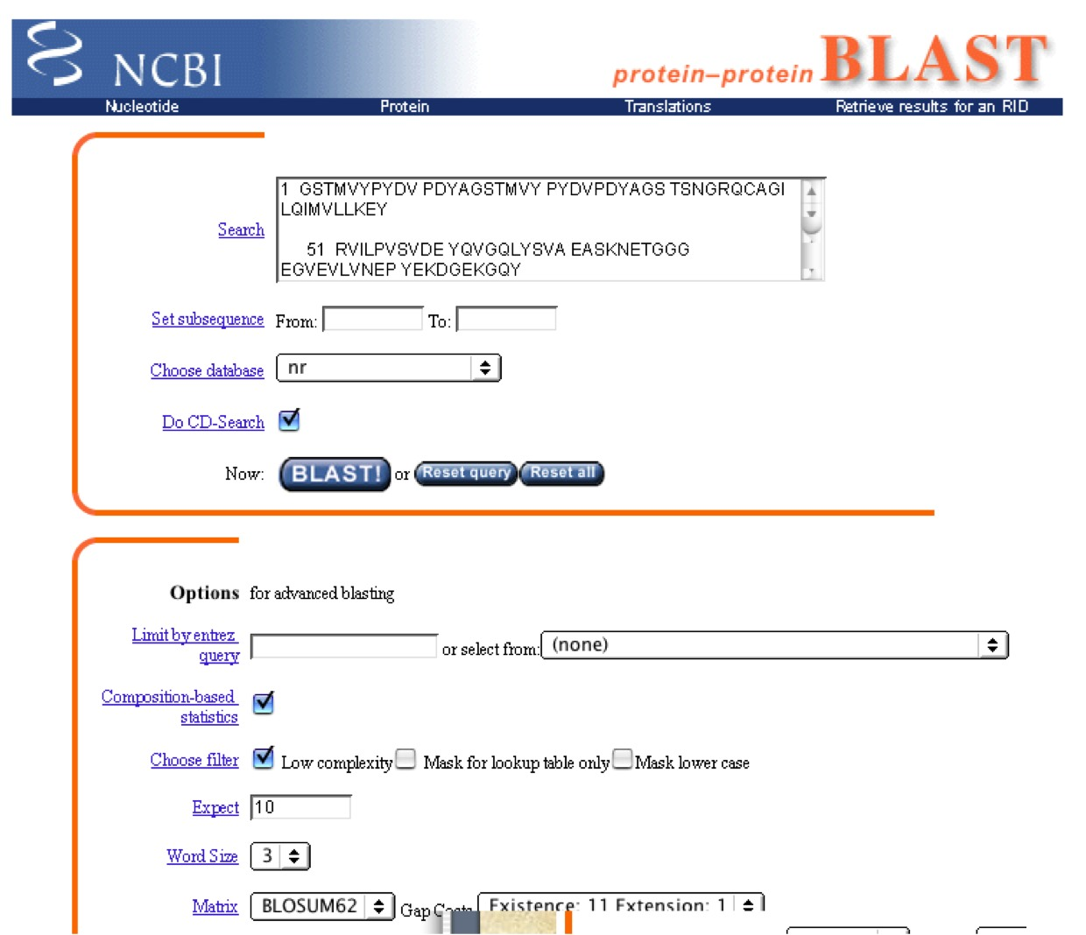

Slide 17
Web BLAST runs on a big computer at NCBI
Usually fast, but does get busy sometimes
Fixed choices of databases
  problems with genome data “clogging” the system
Uses filtering of repeats (by default)
Graphical summary of output
Links to GenBank sequences

Slide 18
BLAST
Similarity matching of words (3 aa’s, 11 bases)
  does not require identical words.
If no words are similar, then no alignment
  won’t find matches for very short sequences
Does not handle gaps well
“gapped BLAST” (BLAST 2) is better

Slide 19
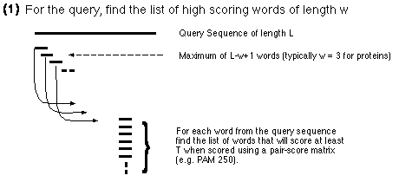
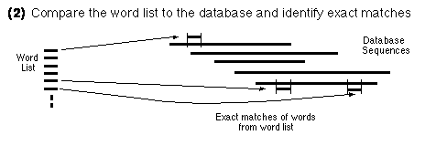
BLAST Algorithm

Slide 20
BLAST Word Matching
MEAAVKEEISVEDEAVDKNI
MEA
EAA
AAV
AVK
VKE
KEE
EEI
EIS
ISV
...
Break query
into words:
Break database
sequences
into words:

Slide 21
Compare Word Lists
Query Word List:
      MEA
      EAA
      AAV
      AVK
      VKL
      KEE
      EEI
      EIS
      ISV
Database Sequence Word Lists
  RTT AAQ
      SDG KSS
      SRW LLN
      QEL RWY
      VKI GKG
      DKI NIS
      LFC WDV
      AAV KVR
      PFR DEI
      … …
?
Compare word lists by Hashing
(allow near matches)

Slide 22
Find locations of matching words
in database sequences
ELEPRRPRYRVPDVLVADPPIARLSVSGRDENSVELTMEAT
  MEA
  EAA
  AAV
  AVK
  KLV
  KEE
  EEI
  EIS
  ISV
TDVRWMSETGIIDVFLLLGPSISDVFRQYASLTGTQALPPLFSLGYHQSRWNY
IWLDIEEIHADGKRYFTWDPSRFPQPRTMLERLASKRRVKLVAIVDPH

Slide 23
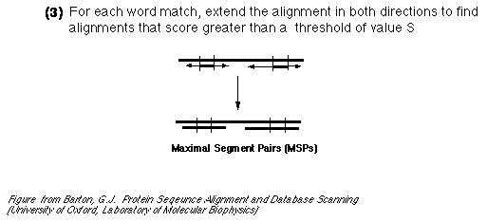
Extend hits one base at a time

Slide 24
BLAST alignments are short segments
BLAST tends to break alignments into non-overlapping segments
can be confusing
reduces overall significance score

Slide 25
HSPs are Aligned Regions
The results of the word matching and attempts to extend the alignment are segments
  - called HSPs (High-_x0008_scoring Segment Pairs)
BLAST often produces several short HSPs rather than a single aligned region

Slide 26
>gb|BE588357.1|BE588357 194087 BARC 5BOV Bos taurus cDNA 5'.
Length = 369
Score = 272 bits (137), Expect = 4e-71
Identities = 258/297 (86%), Gaps = 1/297 (0%)
Strand = Plus / Plus
Query: 17 aggatccaacgtcgctccagctgctcttgacgactccacagataccccgaagccatggca 76
|||||||||||||||| | ||| | ||| || ||| | |||| ||||| |||||||||
Sbjct: 1 aggatccaacgtcgctgcggctacccttaaccact-cgcagaccccccgcagccatggcc 59
Query: 77 agcaagggcttgcaggacctgaagcaacaggtggaggggaccgcccaggaagccgtgtca 136
|||||||||||||||||||||||| | || ||||||||| | ||||||||||| ||| ||
Sbjct: 60 agcaagggcttgcaggacctgaagaagcaagtggagggggcggcccaggaagcggtgaca 119
Query: 137 gcggccggagcggcagctcagcaagtggtggaccaggccacagaggcggggcagaaagcc 196
|||||||| | || | ||||||||||||||| ||||||||||| || ||||||||||||
Sbjct: 120 tcggccggaacagcggttcagcaagtggtggatcaggccacagaagcagggcagaaagcc 179
Query: 197 atggaccagctggccaagaccacccaggaaaccatcgacaagactgctaaccaggcctct 256
||||||||| | |||||||| |||||||||||||||||| ||||||||||||||||||||
Sbjct: 180 atggaccaggttgccaagactacccaggaaaccatcgaccagactgctaaccaggcctct 239
Query: 257 gacaccttctctgggattgggaaaaaattcggcctcctgaaatgacagcagggagac 313
|| || ||||| || ||||||||||| | |||||||||||||||||| ||||||||
Sbjct: 240 gagactttctcgggttttgggaaaaaacttggcctcctgaaatgacagaagggagac 296
Notes:
29

Slide 27
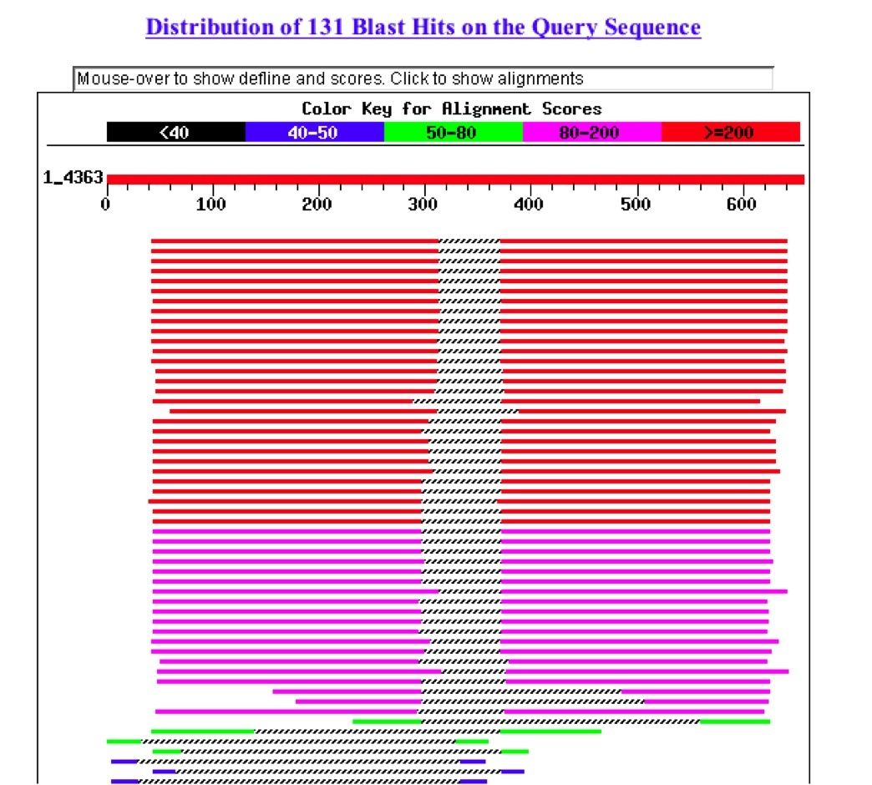
BLAST Results - Summary

Slide 28
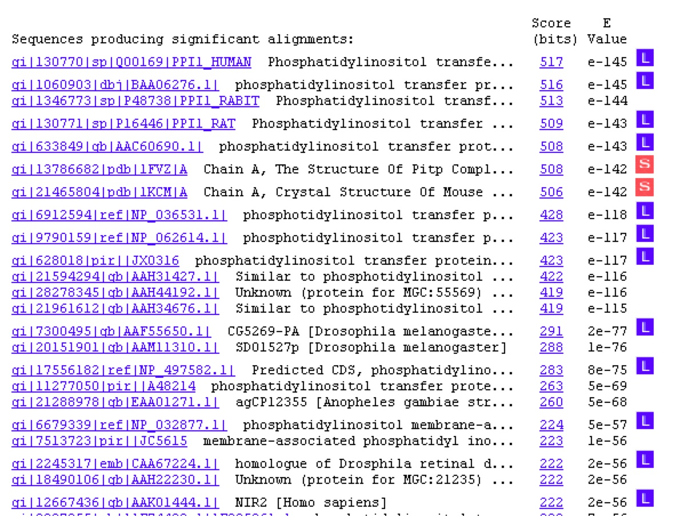
BLAST Results - List

Slide 29
BLAST Results - Alignment
>gi|17556182|ref|NP_497582.1| Predicted CDS, phosphatidylinositol transfer protein
[Caenorhabditis elegans]
gi|14574401|gb|AAK68521.1|AC024814_1 Hypothetical protein Y54F10AR.1 [Caenorhabditis elegans]
Length = 336
Score = 283 bits (723), Expect = 8e-75
Identities = 144/270 (53%), Positives = 186/270 (68%), Gaps = 13/270 (4%)
Query: 48 KEYRVILPVSVDEYQVGQLYSVAEASKNXXXXXXXXXXXXXXPYEK----DGE--KGQYT 101
K+ RV+LP+SV+EYQVGQL+SVAEASK P++ +G+ KGQYT
Sbjct: 70 KKSRVVLPMSVEEYQVGQLWSVAEASKAETGGGEGVEVLKNEPFDNVPLLNGQFTKGQYT 129
Query: 102 HKIYHLQSKVPTFVRMLAPEGALNIHEKAWNAYPYCRTVITN-EYMKEDFLIKIETWHKP 160
HKIYHLQSKVP +R +AP+G+L IHE+AWNAYPYC+TV+TN +YMKE+F +KIET H P
Sbjct: 130 HKIYHLQSKVPAILRKIAPKGSLAIHEEAWNAYPYCKTVVTNPDYMKENFYVKIETIHLP 189
Query: 161 DLGTQENVHKLEPEAWKHVEAVYIDIADRSQVL-SKDYKAEEDPAKFKSIKTGRGPLGPN 219
D GT EN H L+ + E V I+IA+ + L S D + P+KF+S KTGRGPL N
Sbjct: 190 DNGTTENAHGLKGDELAKREVVNINIANDHEYLNSGDLHPDSTPSKFQSTKTGRGPLSGN 249
Query: 220 WKQELVNQKDCPYMCAYKLVTVKFKWWGLQNKVENFIHKQERRLFTNFHRQLFCWLDKWV 279
WK + P MCAYKLVTV FKW+G Q VEN+ H Q RLF+ FHR++FCW+DKW
Sbjct: 250 WKDSVQ-----PVMCAYKLVTVYFKWFGFQKIVENYAHTQYPRLFSKFHREVFCWIDKWH 304
Query: 280 DLTMDDIRRMEEETKRQLDEMRQKDPVKGM 309
LTM DIR +E + +++L+E R+ V+GM
Sbjct: 305 GLTMVDIREIEAKAQKELEEQRKSGQVRGM 334

Slide 30
FASTA/BLAST Statistics
E() value is equivalent to standard P value
Significant if E() < 0.05 (smaller numbers are more significant)
  The E-value represents the likelihood that the observed alignment is due to chance alone. A value of 1 indicates that an alignment this good would happen by chance with any random sequence searched against this database.

Slide 31
BLAST is Approximate
BLAST makes similarity searches very quickly because it takes shortcuts.
  looks for short, nearly identical “words” (11 bases)
It also makes errors
  misses some important similarities
  makes many incorrect matches
    easily fooled by repeats or skewed composition
Notes:
30

Slide 32
Interpretation of output
very low E() values (< e-100) are homologs or identical genes
moderate E() values (~ e-50) are related genes
long list of gradually declining of E() values indicates a large gene family
long regions of moderate similarity are more significant than short regions of high identity

Slide 33
Biological Relevance
It is up to you, the biologist to scrutinize these alignments and determine if they are significant.
Were you looking for a short region of nearly identical sequence or a larger region of general similarity?
Are the mismatches conservative ones?
Are the matching regions important structural components of the genes or just introns and flanking regions?

Slide 34

You are now eligible to test for your black belt in BLAST

Slide 35
FASTA
1) Derived from logic of the dot plot
  compute best diagonals from all frames of alignment
2) Word method looks for exact matches between words in query and test sequence
  hash tables (fast computer technique)
  DNA words are usually 6 bases
  protein words are 1 or 2 amino acids
  only searches for diagonals in region of word
  matches = faster searching

Slide 36
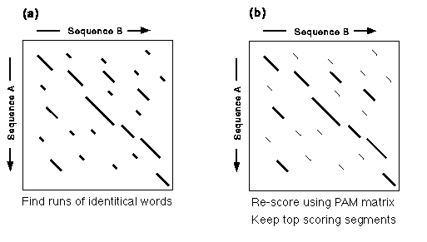
FASTA Algorithm

Slide 37
Makes Longest Diagonal
3) after all diagonals found, tries to join diagonals by adding gaps
4) computes alignments in regions of best diagonals

Slide 38
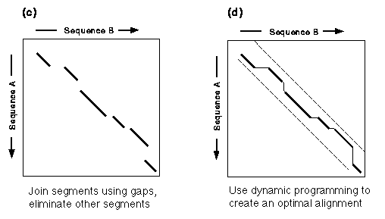
FASTA Alignments

Slide 39
FASTA Results - List
The best scores are: init1 initn opt z-sc E(1018780)..
SW:PPI1_HUMAN Begin: 1 End: 269
! Q00169 homo sapiens (human). phosph... 1854 1854 1854 2249.3 1.8e-117
SW:PPI1_RABIT Begin: 1 End: 269
! P48738 oryctolagus cuniculus (rabbi... 1840 1840 1840 2232.4 1.6e-116
SW:PPI1_RAT Begin: 1 End: 270
! P16446 rattus norvegicus (rat). pho... 1543 1543 1837 2228.7 2.5e-116
SW:PPI1_MOUSE Begin: 1 End: 270
! P53810 mus musculus (mouse). phosph... 1542 1542 1836 2227.5 2.9e-116
SW:PPI2_HUMAN Begin: 1 End: 270
! P48739 homo sapiens (human). phosph... 1533 1533 1533 1861.0 7.7e-96
SPTREMBL_NEW:BAC25830 Begin: 1 End: 270
! Bac25830 mus musculus (mouse). 10, ... 1488 1488 1522 1847.6 4.2e-95
SP_TREMBL:Q8N5W1 Begin: 1 End: 268
! Q8n5w1 homo sapiens (human). simila... 1477 1477 1522 1847.6 4.3e-95
SW:PPI2_RAT Begin: 1 End: 269
! P53812 rattus norvegicus (rat). pho... 1482 1482 1516 1840.4 1.1e-94

Slide 40
FASTA Results - Alignment
SCORES Init1: 1515 Initn: 1565 Opt: 1687 z-score: 1158.1 E(): 2.3e-58
>>GB_IN3:DMU09374 (2038 nt)
initn: 1565 init1: 1515 opt: 1687 Z-score: 1158.1 expect(): 2.3e-58
66.2% identity in 875 nt overlap
(83-957:151-1022)
60 70 80 90 100 110
u39412.gb_pr CCCTTTGTGGCCGCCATGGACAATTCCGGGAAGGAAGCGGAGGCGATGGCGCTGTTGGCC
|| ||| | ||||| | ||| |||||
DMU09374 AGGCGGACATAAATCCTCGACATGGGTGACAACGAACAGAAGGCGCTCCAACTGATGGCC
130 140 150 160 170 180
120 130 140 150 160 170
u39412.gb_pr GAGGCGGAGCGCAAAGTGAAGAACTCGCAGTCCTTCTTCTCTGGCCTCTTTGGAGGCTCA
||||||||| || ||| | | || ||| | || || ||||| ||
DMU09374 GAGGCGGAGAAGAAGTTGACCCAGCAGAAGGGCTTTCTGGGATCGCTGTTCGGAGGGTCC
190 200 210 220 230 240
180 190 200 210 220 230
u39412.gb_pr TCCAAAATAGAGGAAGCATGCGAAATCTACGCCAGAGCAGCAAACATGTTCAAAATGGCC
||| | ||||| || ||| |||| | || | |||||||| || ||| ||
DMU09374 AACAAGGTGGAGGACGCCATCGAGTGCTACCAGCGGGCGGGCAACATGTTTAAGATGTCC
250 260 270 280 290 300
240 250 260 270 280 290
u39412.gb_pr AAAAACTGGAGTGCTGCTGGAAACGCGTTCTGCCAGGCTGCACAGCTGCACCTGCAGCTC
|||||||||| ||||| | |||||| |||| ||| || ||| || |
DMU09374 AAAAACTGGACAAAGGCTGGGGAGTGCTTCTGCGAGGCGGCAACTCTACACGCGCGGGCT
310 320 330 340 350 360

Slide 41
FASTA on the Web
Many websites offer FASTA searches
  Various databases and various other services
  Be sure to use FASTA 3
Each server has its limits
Be aware that you are depending on the kindness of strangers.

Slide 42
Institut de Génétique Humaine, Montpellier France, GeneStream server
    http://www2.igh.cnrs.fr/bin/fasta-guess.cgi
Oak Ridge National Laboratory GenQuest server
http://avalon.epm.ornl.gov/
European Bioinformatics Institute, Cambridge, UK
http://www.ebi.ac.uk/htbin/fasta.py?request
EMBL, Heidelberg, Germany
http://www.embl-heidelberg.de/cgi/fasta-wrapper-free
Munich Information Center for Protein Sequences (MIPS)
at Max-Planck-Institut, Germany
http://speedy.mips.biochem.mpg.de/mips/programs/fasta.html
Institute of Biology and Chemistry of Proteins Lyon, France
http://www.ibcp.fr/serv_main.html
Institute Pasteur, France
http://central.pasteur.fr/seqanal/interfaces/fasta.html
GenQuest at The Johns Hopkins University
http://www.bis.med.jhmi.edu/Dan/gq/gq.form.html
National Cancer Center of Japan
http://bioinfo.ncc.go.jp

Slide 43
Advanced Similarity Techniques
Automated ways of using the results of one search to initiate multiple searches
INCA (Iterative Neighborhood Cluster Analysis) http://itsa.ucsf.edu/~gram/home/inca/
  Takes results of one BLAST search, does new searches with each one, then combines all results into a single list
  JAVA applet, compatibility problems on some computers
PSI BLAST http://www.ncbi.nlm.nih.gov/Education/BLASTinfo/psi1.html
  Creates a “position specific scoring matrix” from the results of one BLAST search
  Uses this matrix to do another search
  builds a family of related sequences
  can’t trust the resulting e-values

Slide 44
PSI BLAST
Starts with a single BLAST search
    only works on PROTEIN
Finds matches: builds a new scoring matrix just for this set of sequences
Use the new matrix to search for more distant matches
Repeat
Results are only as good as your intial set of sequences used to build the matrix

Slide 45
Database to Search
The biggest factor that affects the results of a similarity search, is …obviously… what database you search
Choose to search PROTEIN databases whenever possible
  Smaller = less redundant = higher e-values
  Non-identical letters have information (scoring matrix)

Slide 46
Comprehensive vs Annotated
It is NOT always best to search the biggest, most comprehensive database
What have you learned when your cloned sequence matches a "hypothetical gene?"
RefSeq is the best annotated DNA database
SwissProt is the best annotated protein database

Slide 47
What are you looking for?
Usually you want to search annotated genes
If you don't find anything, you might want to search ESTs (sequences of mRNA fragments)
ESTs are not included in the default "nr" GenBank database

Slide 48
Limit by species
If you know your sequence is from one species
Or you want to limit your search to just that species…
use the ENTREZ limits feature

Slide 49
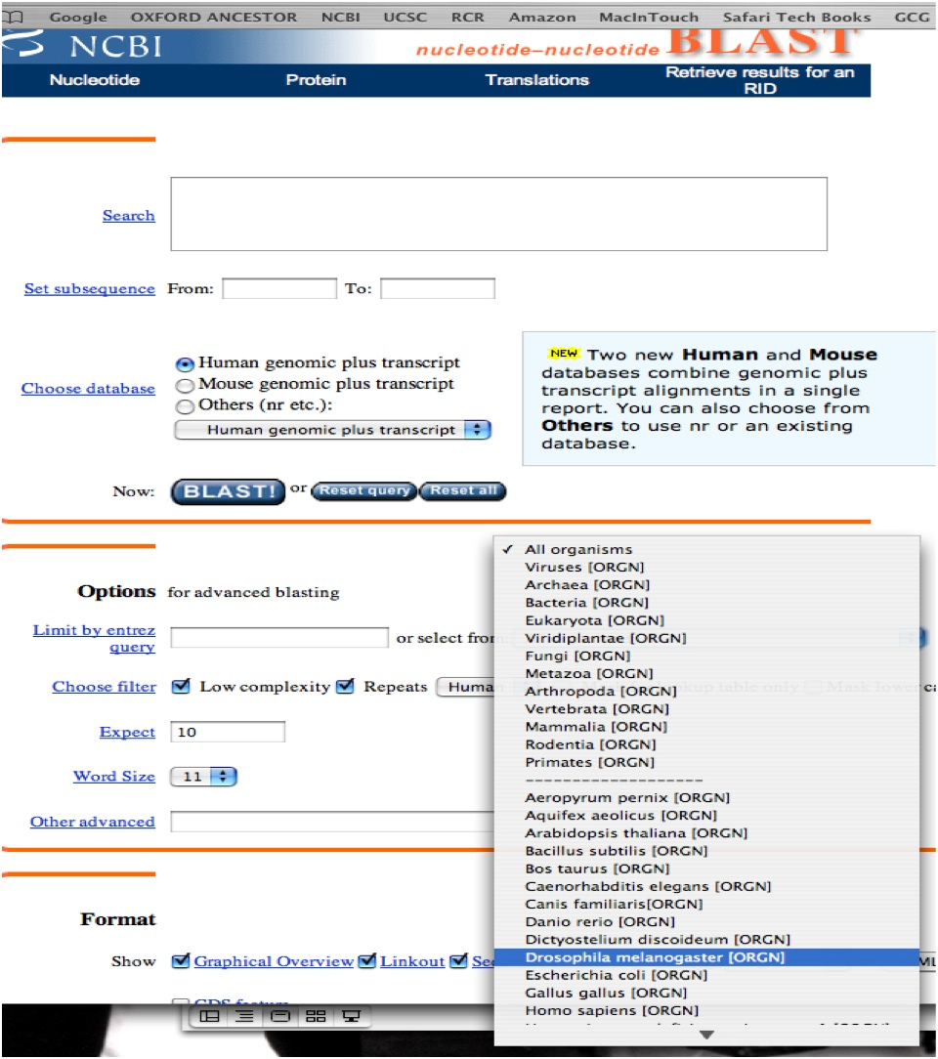

Slide 50
Filters
BLAST is easily fooled by repeats and low complexity sequence (enriched in a few letters = DNA microsatellites, common acidic, basic or proline-rich regions in proteins)
Default filters remove low complexity from protein searches and known repeats (ie. Alu) from DNA searches
Removes the problem sequences before running the BLAST search
You can turn off the filters to get true alignments and e-values ("lookup only")

Slide 51
Size Matters
Short sequences can't get good e-values
What is the probability of finding a 12 base fragment in a "random" genome?
4¹² = 16,777,216 (once per 16 million bases)
What length DNA fragment is needed to define a unique location in the genome?
4¹⁶ = 4,294,967,296 (4 billion bases)
So, what is the best e-value you can get for a 16 base fragment?

Slide 52
Word size
BLAST uses a default word size of 11 bases for DNA
Short sequences will have few words
Low quality sequence might have a sequencing error in every word
"MegaBlast" uses very large words (28)
  allows for fast mRNA > genome alignment
  allows huge sequences to be use as query
"Search for short, nearly exact matches"
    word size = 7, expect = 1000

Slide 53
Batch BLAST
What if you need to do a LOT of BLAST searches?
NCBI www BLAST server will accept a FASTA file with multiple sequences
NCBI has a BLAST client program: blastcl3 (Unix, Windows, and Mac)
NETBLAST is a scriptable BLAST client in GCG package

Slide 54
Accelerated BLAST
The BLAST algorithm can run on special parallel computing hardware
At NYU, the RCR runs a super BLAST server:
  http://codequest.med.nyu.edu
  Can create custom databases for your project

Slide 55
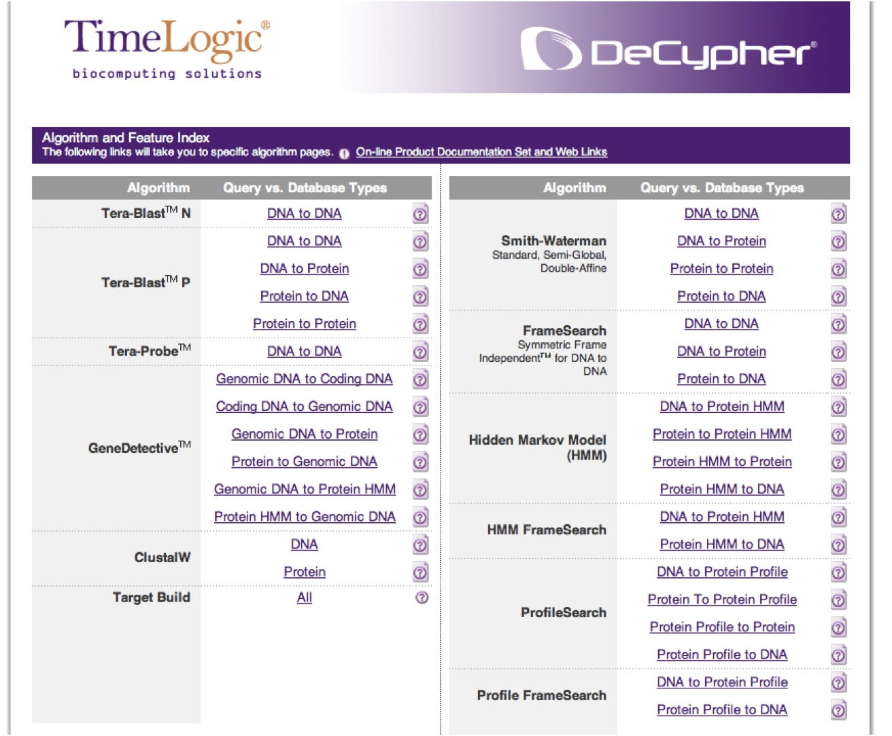

Slide 56
Lots of Results
Batch or acclerated BLAST searches produce lots of results files.
What to do with them?
BlastReport2 is a Perl script from NCBI to sort out results from a batch BLAST.
"BlastReport2 is a perl script that reads the output of Blastcl3, reformats it for ease of use and eliminates useless information."

Slide 57
BLAST Parser
Hundreds of different people have written programs to sort BLAST results
(including myself)
Better to use a common code base
BioPerl is a collection of public Perl modules including several BLAST parsers

Slide 58
ESTs have frameshifts
How to search them as proteins?
Can use TBLASTN but this breaks each
frame-shifted region into its own little protein
GCG FRAMESEARCH is killer slow
  (uses an extended version of the Smith-Waterman algorithm)
FASTX (DNA vs. protein database) and TFASTX (protein vs. DNA database) search for similarity taking account of frameshifts

Slide 59
Genome Alignment
How to match a protein or mRNA to genomic sequence?
  There is a Genome BLAST server at NCBI
  Each of the Genome websites has a similar search function
What about introns?
  An intron is penalized as a gap, or each exon is treated as a separate alignment with its own e-score
  Need a search algorithm that looks for consensus intron splice sites and points in the alignment where similarity drops off.

Slide 60
Sim4 is for mRNA -> DNA Alignment
Florea L, Hartzell G, Zhang Z, Rubin GM, Miller W. A computer program for aligning a cDNA sequence with a genomic DNA sequence. Genome Res. 1998 8:967-74
This is a fairly new program (1998) as compared to BLAST and FASTA
It is written for UNIX (of course), but there is a web server (and it is used in many other 'genome analysis' tools): http://pbil.univ-lyon1.fr/sim4.html
Finds best set of segments of local alignment with a preference for fragments that end with splice-site recognition signals (GT-AG, CT-AC)

Slide 61
More Genome Alignment
Est2Genome: like it says, compares an EST to genome sequence)
http://bioweb.pasteur.fr/seqanal/interfaces/est2genome.html
GeneWise: Compares a protein (or motif) to genome sequence
http://www.sanger.ac.uk/Software/Wise2/genewiseform.shtml

Slide 62
What program to use for searching?
1) BLAST is fastest and easily accessed on the Web
  limited sets of databases
  nice translation tools (BLASTX, TBLASTN)
2) FASTA
precise choice of databases
  more sensitive for DNA-DNA comparisons
  FASTX and TFASTX can find similarities in sequences with frameshifts
3) Smith-Waterman - slower, but more sensitive
  known as a “rigorous” or “exhaustive” search
  SSEARCH in GCG and standalone FASTA

Slide 63
Smith-Waterman searches
A more sensitive brute force approach to searching
much slower than BLAST or FASTA
uses dynamic programming
SSEARCH is a GCG program for Smith-Waterman searches
WATER is an EMBOSS program for Smith-Waterman searches

Slide 64
Smith-Waterman on the Web
The EMBL offers a service know as BLITZ, which actually runs an algorithm called MPsrch on a dedicated MassPar massively parallel super-computer.
http://www.ebi.ac.uk/bic_sw/
The Weizmann Institute of Science offers a service called the BIOCCELERATOR provided by Compugen Inc.
http://sgbcd.weizmann.ac.il:80/cgi-bin/genweb/main.cgi

Slide 65
Strategies for similarity searching
1) Web, PC program, GCG, or custom client?
2) Start with smaller, better annotated databases (limit by taxonomic group if possible)
3) Search protein databases (use translation for DNA seqs.) unless you have non-coding DNA

